Slide 1





01/14
EMAIL HARASSMENT
INVESTIGATION
Nitroba State University
Presented by: Abdul Rafay
Date: August 2nd, 2025

Slide 2
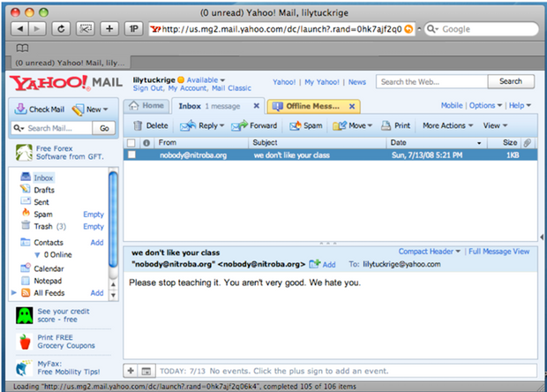
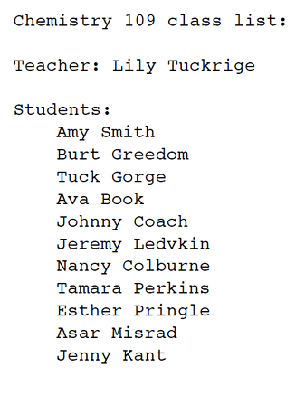
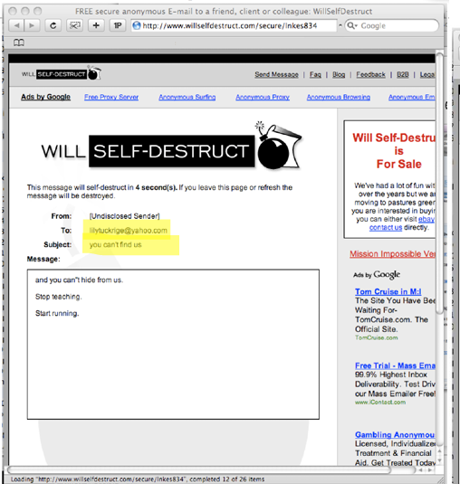
SCENARIO
OVERVIEW
02/14
The Incident
Key Aspects
IT Response
Victim: Dr. Lily Tuckrige, Chemistry Instructor
Issue: Received anonymous harassing emails at her personal Yahoo account (lilytuckrige@yahoo.com)
First Email (July 13): Spoofed as nobody@nitroba.org.
Second Email (July 21): Sent via willselfdestruct.com (self-destructing message)
Harassment Source: Emails traced to Nitroba’s dorm network (140.247.62.34).
Suspect Pool: Likely a student from Dr. Tuckrige’s CHEM109 class.
Network Vulnerability: Unsecured Wi-Fi router in dorm room enabled anonymous access.
Deployed packet sniffer after first complaint.
Captured traffic (nitroba.pcap) revealing attacker’s activity.

Slide 3


INVESTIGATION
OBJECTIVES
03/14
Primary Goal
Key Questions
Identify if the harasser using forensic analysis of:
Network traffic (nitroba.pcap)
Email headers
Device/IP correlations
Who sent the emails?
How was anonymity bypassed?
What evidence links the attacker to the class?

Slide 4

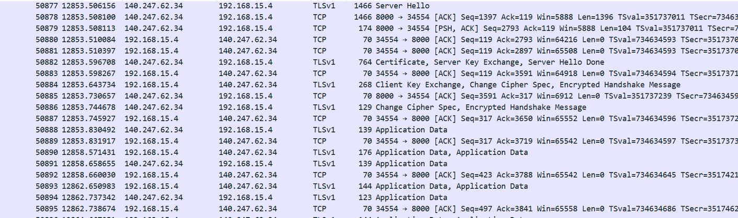
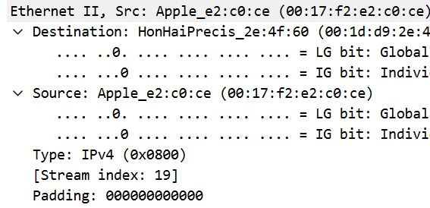
04/14
Only one active host (192.168.15.4) detected during harassment incidents
MAC address 00:17:f2:e2:c0:ce (Apple device) linked to all malicious traffic
Traffic routed through NAT gateway 140.247.62.34 (dorm's public IP)
Unsecured Wi-Fi router installed by student's boyfriend enabled anonymous access
No other devices active during attack timeframe (11:00-11:15 PM)
NETWORK ENVIRONMENT
ANALYSIS

Slide 5



05/14
Tools & Techniques
Primary Tool: Wireshark (analysis of nitroba.pcap)
Key Filters Applied:
ip.addr == 140.247.62.34 → Mapped to internal IP
http.host contains "willselfdestruct.com" → Located Packet #83601
eth.src == 00:17:f2:e2:e0:ce → Tracked attacker's device
FORENSIC
METHODOLOGY
Investigation Steps:
Identified all HTTP POST requests to anonymous email services
Correlated timestamps with reported harassment incidents
Extracted MAC/IP address of suspect device

Slide 6
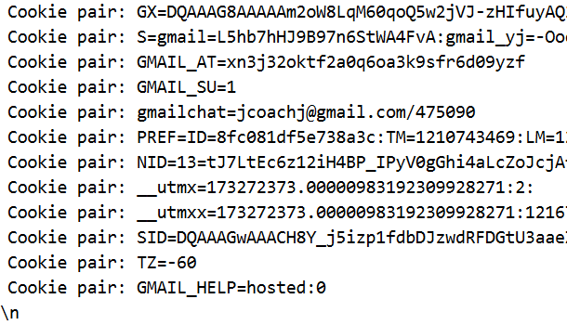
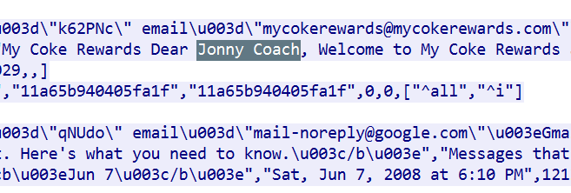
CRITICAL EVIDENCE
DISCOVERED
06/14
Gmail session exposure: jcoachj@gmail.com (Packet #78967)
"Dear Jonny Coach" identifier in My Coke Rewards email
Matching MAC address across both harassment emails
Sequential access to Gmail → anonymous services → victim's address
No other network activity during attack window
DNS queries for malicious services matched exact harassment times

Slide 7
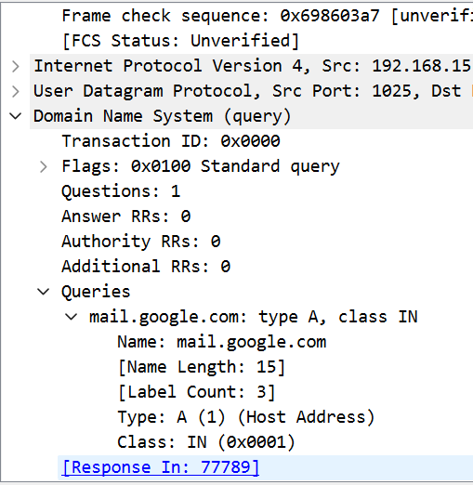
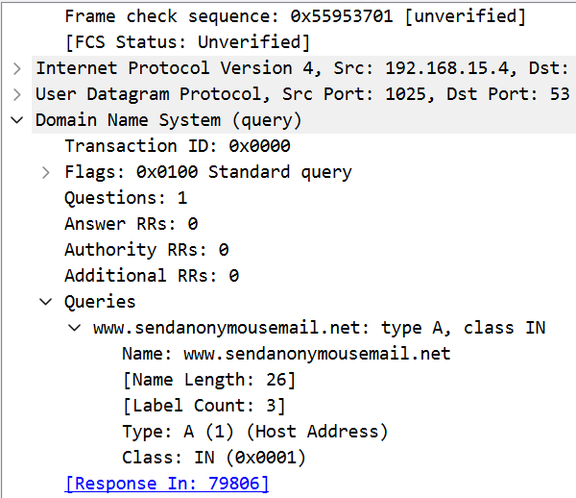
ATTACK TIMELINE
RECONSTRUCTION
07/14
11:01 PM - Gmail login (DNS Packet #77788)
11:01:26 PM - DNS query for sendanonymousemail.net

Slide 8
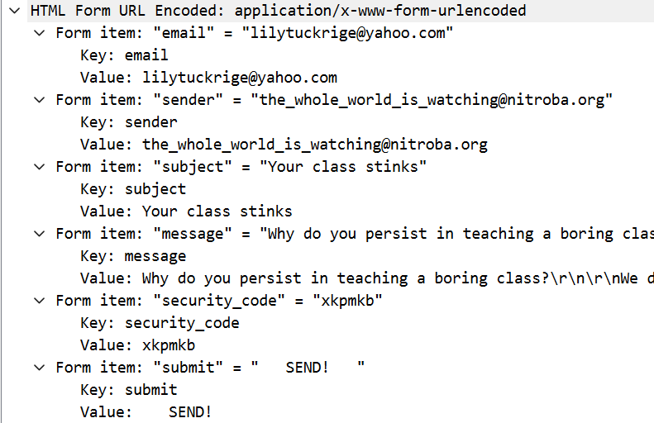
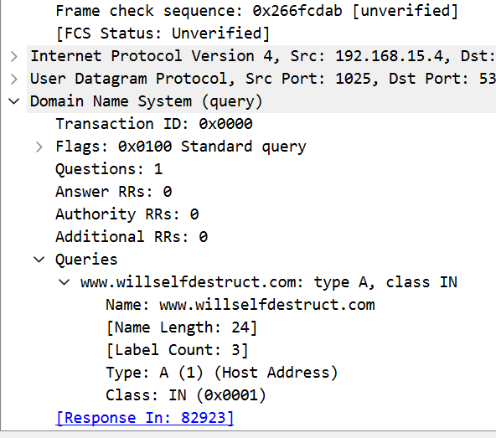
ATTACK TIMELINE
RECONSTRUCTION
08/14
11:02:57 PM - First harassing email sent (Packet #80614)
11:03:43 PM - DNS query for willselfdestruct.com

Slide 9
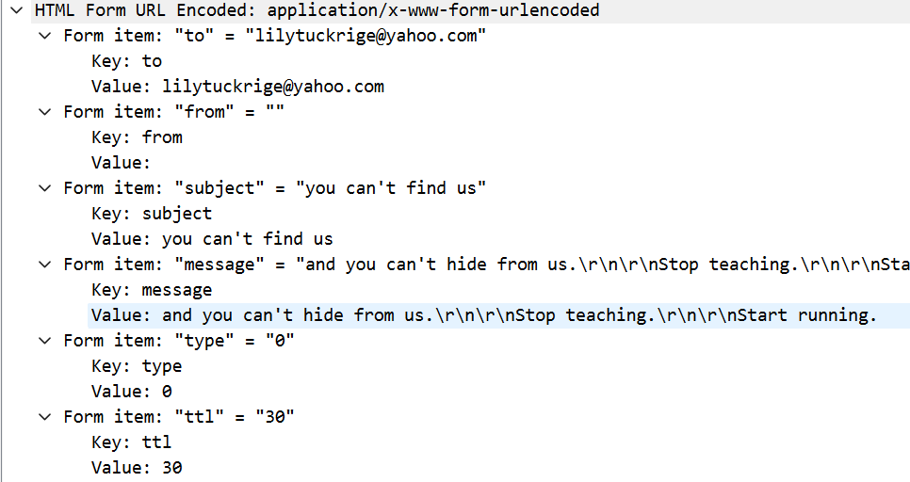
ATTACK TIMELINE
RECONSTRUCTION
09/14
11:04:24 PM - Second harassing email sent (Packet #83601)

Slide 10


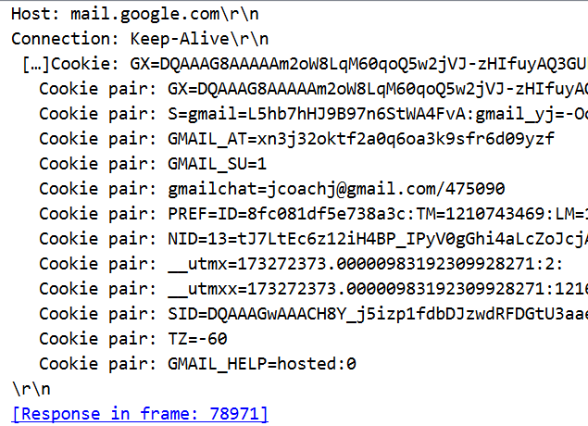
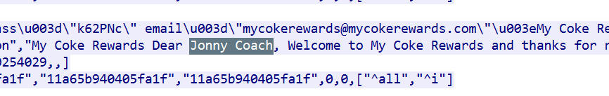
10/14
Device MAC matches Apple laptop registered to student
Gmail account belongs to CHEM109 enrollee
Personal identifier ("Jonny Coach") in cached emails
No evidence of device sharing during incident
Behavioral pattern matches class schedule
Prior access to victim's course materials
ATTACKER
IDENTIFICATION

Slide 11


11/14
Immediate Actions
Revoke network access for MAC 00:17:f2:e2:c0:ce
Confiscate attacker's device for forensic preservation
Document chain of custody for disciplinary proceedings
REMEDIATION &
RECOVERY
Long term Solutions
Implement WPA3 encryption on all dorm networks
Deploy network monitoring for anonymous service usage
Mandate cybersecurity training for all students
Establish clear sanctions for harassment violations

Slide 12
12/14
Unsecured Wi-Fi creates accountability gaps
Anonymous email services enable harassment
Packet-level logging is essential for attribution
Device fingerprints (MAC/IP) are critical evidence
User education can prevent future incidents
Rapid response limits attacker opportunities
LESSONS
LEARNED

Slide 13
13/14
COMPLETION
SUMMARY
Harassment Source Identification
Technical Analysis
Confirmed CHEM109 student (Johnny Coach) as sender
i. Dorm network mapped:
Single active host (192.168.15.4)
Unsecured Wi-Fi router (Kenny's device)
ii. Attacker identified via:
Gmail session (jcoachj@gmail.com)
MAC 00:17:f2:e2:c0:ce
iii. Attacker's TCP connections:
mail.google.com (Gmail)
sendanonymousemail.net
willselfdestruct.com
iv. Identity proof:
My Coke Rewards email ("Dear Jonny Coach")
Tools: Wireshark (nitroba.pcap)
Key Filters:
ip.addr == 140.247.62.34
http.host contains "willselfdestruct.com"
eth.src == 00:17:f2:e2:e0:ce
Data Files:
Packet captures (#80614, #83601, etc)
DNS query logs
Gmail session screenshots

Slide 14
14/14
THANK
YOU!

